Slide 1

Basics of Scaling Gopinath M,RD I/CEE MBRDI, Bengaluru 18-Jun-2019

Slide 2
Agenda
Introduction to scalings
Entities in scalings
Fixed & Float point notation
TL scaling options
Speed/Accuracy Trade Off
Overflow and underflow
Determine the scalings
Use of Autoscaling tool

Slide 3
Introduction to Scalings
Scaling is to specify the value range, offset and resolution of a variable
To avoid overflow conditions and minimize quantization errors, fixed-point numbers must be scaled
Scaling is important for TargetLink model since code generated depends on the scaling which is specified

Slide 4
Entities in scalings
Value range :
- UINT8 : 0 - 255
- UINT16 : 0 - 65535
- UINT32 : 0 - 4294967295
Offset : - Specifies the value to be displaced either in positive or negative
Resolution: - It specifies the accuracy of the value that is calculated Physical value = (raw value x resolution) + Offset
Ex 1: a = (255 x 0.1) + (-2) Ex 2: b = (65535 x 0.01) + 0
Now the variable ‘a’ can support values from -2 to 23.5 The variable ‘b’ can support values from 0 to 655.35

Slide 5
Fixed point notation
Fixed point number has a specific number of bits (or digits) reserved for the integer part (the part to the left of the decimal point) and a specific number of bits reserved for the fractional part.
Fixed point notation without offset: A is UInt16 with 0.01 res In model, A = 42.05+ 42.08 In C code, when evaluated, it will be as A = (4205+4208)/100 (Rational : 42.05/0.01 A = 84.13 : 42.08/0.01)
Fixed point notation with offset: A is UInt16 with 0.01 res and -20 as offset In model, A = 42.05+ 42.08 In C code, when evaluated, it will be as A = (((2205/100)+20)+((2208)/100)+20) (Rational : (42.05-20)/0.01 A = 84.13 : (42.08-20)/0.01)

Slide 6
Floating point notation
A floating point number does not reserve a specific number of bits for the integer part or the fractional part

Slide 7
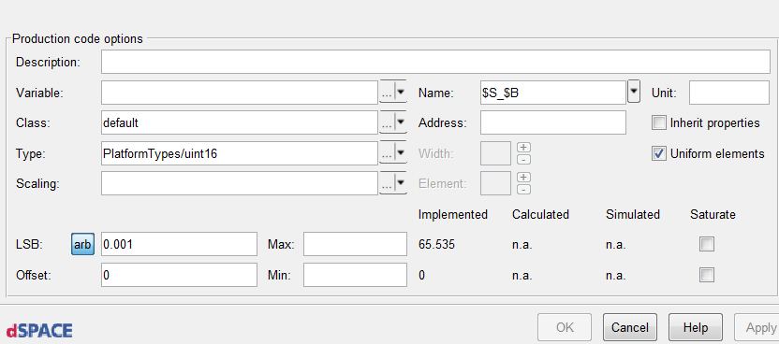
TL Scaling options
Inherit from previous block
Base type
Resolution Offset

Slide 8
Speed/Accuracy Trade Off
High
Execution Speed
Low
2^
2^ + Offset
Arbitrary
Arbitrary + Offset
Low
Accuracy
High

Slide 9
Overflows & Underflows
When the mathematical operation results in exceeding the supported range, then overflow or underflow occurs.
Overflow example: - Variable ‘A’ is scaled with UINT8 with 0 offset. Below will have overflow. Expression : A = 60+200 Value of A will be 4 instead of 260 (Rational : …255->0->1->2->3->4)
- Variable ‘B’ is scaled with SINT16 with 0 offset. Below will have overflow. Expression : A = 32767 + 1 Value of A will be -32768 instead of 32768

Slide 10
Overflows & Underflows
Underflow example: - Variable ‘A’ is scaled with UINT8 with 0 offset. Below will be underflow situation. Expression : A = 60-70 Value of A will be 246 instead of -10 (Rational : …0->255->254->253->252->251->250->249->248->247->246)
- Variable ‘B’ is scaled with SINT16 with 0 offset. Below will be underflow situation. Expression : A = -32768-1 Value of A will be 32767 instead of -32769

Slide 11
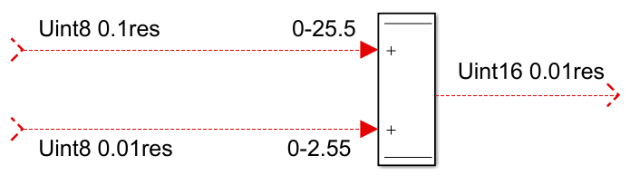
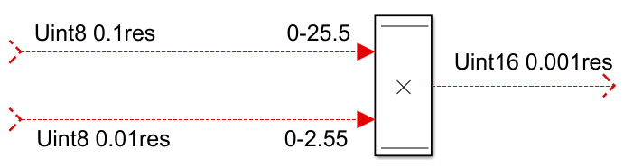
Determine scalings
Addition/Sub operation:
For output, using uint8 with 0.1 will lose the accuracy of 0.01 from second input. And using uint8 with 0.01 will lose value from first input. Hence going for higher range will fit the value and accuracy.
Multiplication operation:
For multiplication, value range and resolution of two inputs can be multiplied respectively.
Mul value : 25.5 x 2.55 = 65.025

Slide 12
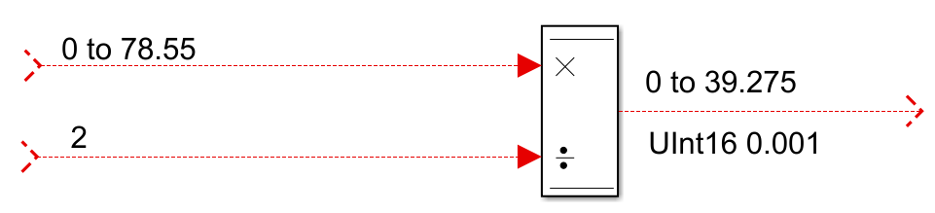
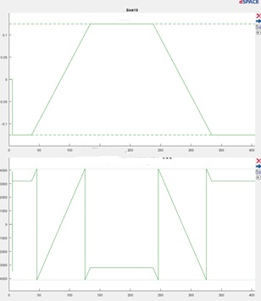
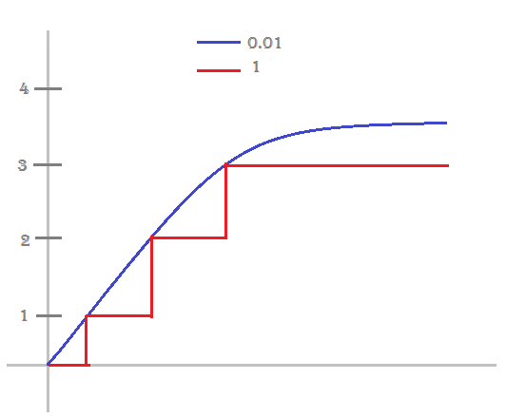
Determine scalings
Division operation:
For division operation, dividend’s value range shall be divided and checked with divisor’s value range. Based on the divided value range, final scaling can be made.
Accuracy variation
Overflow
Accuracy variation

Slide 13
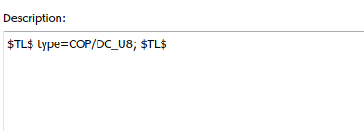
TL Scaling options
Datatype specification for stateflow in model explorer
For Delay and Switch block, by default inherit option should be enabled
LSB can be specified in arbitrary or in power of 2 form For UINT16 (65535), arb of 0.001 will give max value of 65.355 with 0.001 resolution For UINT16 (65535), 2^-1 will give max value of 32767.5
In Stateflow, output and the local variable must be scaled. If not scaled, TargetLink will generate a float in the code

Slide 14
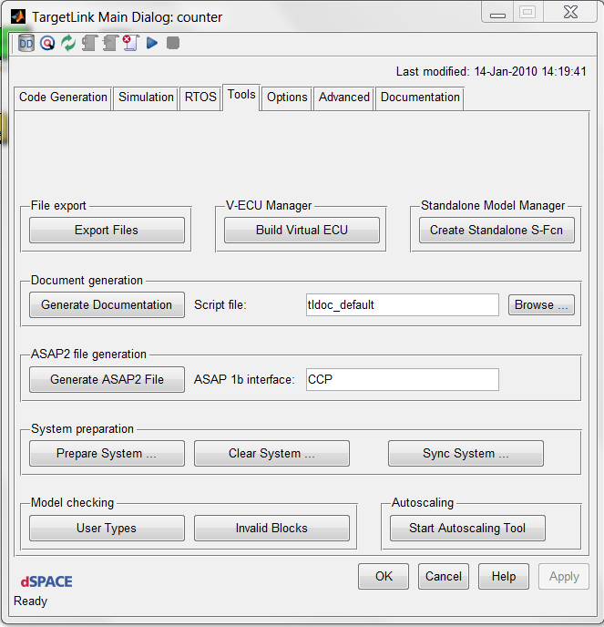
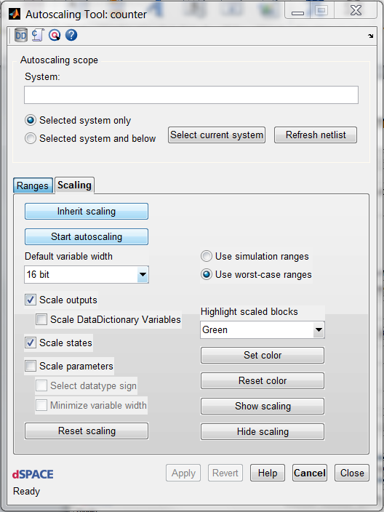
Using Autoscaling tool

Slide 15
Using Autoscaling tool
Precondition: Model ready for compilation
1.Open the Autoscaling Tool and switch to Scaling page.
2.Select the subsystem to be scaled.
3.Select "Use simulation ranges".
4.Specify the scaling options.
5.Scale Outputs, States, Parameters?
6.Start autoscaling.
7.TL asks whether to use the netlist or not.
8.With a netlist the scaling of neighbored blocks can be taken into account.
Disable autoscaling for successfully scaled blocks.

Slide 16
Thank You
Useful links:
https://www.dspace.com/en/pub/home/medien/videos/productvideos/video-tl-codeproperties.cfm

